Slide 1
Suffix -an
with

Slide 2




review
challenge
partner talk
check
introduce
say
write
grammarsaurus.co.uk

Slide 3


1
-ous
full of
grammarsaurus.co.uk
Latin Greek
Old English
wiitthh
grammarsaurus.co.uk

Slide 4
per-
completely, thoroughly or through
grammarsaurus.co.uk
Latin Greek
Old English
wiitthh
grammarsaurus.co.uk

Slide 5

sub-
under
grammarsaurus.co.uk
Latin Greek
Old English
wiitthh
grammarsaurus.co.uk

Slide 6
tract
pull or drag
Latin Greek
Old English
grammarsaurus.co.uk
wiitthh
grammarsaurus.co.uk

Slide 7



auto
self
grammarsaurus.co.uk
Latin Greek
Old English
wiitthh
grammarsaurus.co.uk

Slide 8

-ion
act or
process
grammarsaurus.co.uk
Latin Greek
Old English
wiitthh
grammarsaurus.co.uk

Slide 9




-an
person with a skill,
belief or linked to
Latin Greek
Old English
with
grammarsaurus.co.uk
with
grammarsaurus.co.uk

Slide 10



-an
We have already looked at the suffix -an.
We know that the suffix –an fixes after a base to show a "person with a skill, belief or linked to something".
person with a skill,
belief or linked to
Latin Greek
Old English
with
grammarsaurus.co.uk
with
grammarsaurus.co.uk

Slide 11



We already know that when a stem ends in a final letter y after a
consonant letter, we need to change y to i, then add the suffix.
Like in this word sum…
A historian is a person with a skill, belief or is linked to history.
history ^{i} an = historian
We are going to explore how some stems need to make changes before we can add the suffix –an.
grammarsaurus.co.uk

Slide 12





A historian would need a lot of knowledge about periods in history.
Many historical periods are named based on the person “linked to”
that period.
Emperor Augustus
Queen Elizabeth I
James I
King
George I - IV
Queen Victoria
King Edward VII
Roman Empire 27 BCE – 14 CE
1558 - 1603
1603 - 1625
1714 - 1830
1837 - 1901
1901 - 1910
grammarsaurus.co.uk

Slide 13






Let’s become historians!
Roman Empire 27 BCE – 14 CE
Emperor Augustus was the founder of the Roman Empire and the adopted son of Julius Caesar. To mark several of his key victories and personal achievements, the Roman Senate renamed the month Sextilis (the sixth month of the old Roman calendar) as August in Augustus’s honour.
The month of July, (originally named Quintilis as the fifth month of the old Roman calendar) had
already been renamed after Julius Caesar.
August an = Augustan
We can add the suffix –an to the base August (from Augustus) to form the word Augustan. We use the word Augustan to refer to someone or something “linked to” the time of Emperor Augustus (the first Roman emperor).
grammarsaurus.co.uk

Slide 14




Let’s become historians!
Queen Elizabeth I 1558 - 1603
Queen Elizabeth I was the daughter of Henry VIII and Anne Boleyn. Queen Elizabeth I was known for being a powerful queen who never married. She was clever, strong, and helped keep England safe and united.
During this time there was a flourish in literature, especially drama and poetry. William Shakespeare,
a famous playwright, featured in this period in history.
Elizabeth an = Elizabethan
We can add the suffix –an to the base Elizabeth to form the word Elizabethan.
We use the word Elizabethan to refer to someone or something “linked to” the time when Queen Elizabeth I was in power.
grammarsaurus.co.uk

Slide 15


Let’s become historians!
James I
1603 - 1625
After Queen Elizabeth I died, her cousin’s son James became king. He was already the king of Scotland (as James VI), and when he became king of England too, he united the two kingdoms. He is most famous for the King James Bible (a translation of the Bible into English that many people still read today).
The name James in Latin is Jacobus (like an alternate of the name James).
We need the connecting vowel letter, letter e, to link the suffix –an to the base to help with smooth pronunciation.
Jacob e an = Jacobean
*CVL
We can form the word Jacobean by combining base Jacob, a connecting vowel letter e, and the
suffix -an. We use the word Jacobean to refer to someone or something “linked to” the time when King James reigned.
*connecting vowel letter
grammarsaurus.co.uk

Slide 16




Let’s become historians!
King George I – IV 1714 - 1830
There were four kings of Britain who were all named George from 1714 – 1830. Throughout this time there became a big divide between rich and poor. Rich people wore powdered wigs, fancy dresses, and elegant coats. Architecture developed with the building of big, elegant townhouses.
We need the connecting vowel letter, letter i, to link the suffix –an to the base to help with smooth pronunciation.
George i an = Georgian
*CVL
We can add the suffix –an to the base George to form the word Georgian with the connecting vowel letter i that precedes the suffix. We use the word Georgian to refer to someone or something “linked to” the time when all four kings named George were in power.
*connecting vowel letter
grammarsaurus.co.uk

Slide 17


Let’s become historians!
Queen Victoria 1837 - 1901
Queen Victoria became queen at just 18 years old. She had 9 children and ruled for 63 years – one of the longest reigns in British history. Throughout this period in history, people dressed very formally. Women wore long dresses, corsets, and hats, and men wore suits, top hats, and sometimes monocles!
During this time, Charles Dickens wrote stories like Oliver Twist and A Christmas Carol.
Vict or i an = Victorian
The base of the name Victoria is vict meaning “win or conquer” from the Latin root vincere. We can combine base vict with suffix -or meaning “one who” which forms the word victor. Using a CVL i followed by the suffix -an, we can form the word Victorian. We use this word to refer to someone or something “linked to” the time when Queen Victoria was in power.
*CVL
*connecting vowel letter
grammarsaurus.co.uk

Slide 18









Let’s become historians!
King Edward VII 1901 - 1910
King Edward was the son of Queen Victoria. He became the king when Queen Victoria died. Edward was only king for 9 years. In this time, electric lights, telephones, cars and aeroplanes became more common. People became excited about science and progress in England. They started to ask for more rights and fairness, especially for workers and women. The women’s suffrage movement (for women to vote) was growing stronger.
We need the connecting vowel letter, letter i, to link the suffix –an to the base to help with smooth pronunciation.
Edward i an = Edwardian
*CVL
We can add the suffix –an to the base Edward to form the word Edwardian with the connecting vowel letter i that precedes the suffix. We use the word Edwardian to refer to someone or something “linked to” the time when King Edward was in power.
*connecting vowel letter
grammarsaurus.co.uk

Slide 19





Can you name the historical era? The word is “linked to” the person that was in power throughout that time.
This period shares the base of a month of the year.
Known for Shakespeare and a powerful queen.
You need to know the Latin word for James.
Four kings with the same name ruled throughout this time.
People dressed very formally throughout this time.
Early cars and planes started to be seen in this period.
27 BCE – 14 CE
1558 - 1603
1603 - 1625
1714 - 1830
1837 - 1901
1901 - 1910
grammarsaurus.co.uk

Slide 20
How did you do?
This period shares the base of a month of the year.
Known for Shakespeare and a powerful queen.
You need to know the Latin word for James.
Four kings with the same name ruled throughout this time.
People dressed very formally throughout this time.
Early cars and planes started to be seen in this period.
Augustan
Elizabethan
Jacobean
Georgian
Victorian
Edwardian
27 BCE – 14 CE
1558 - 1603
1603 - 1625
1714 - 1830
1837 - 1901
1901 - 1910
grammarsaurus.co.uk

Slide 21
2
-ous
full of
grammarsaurus.co.uk
Latin Greek
Old English
wiitthh
grammarsaurus.co.uk

Slide 22
per-
completely, thoroughly or through
grammarsaurus.co.uk
Latin Greek
Old English
wiitthh
grammarsaurus.co.uk

Slide 23
sub-
under
grammarsaurus.co.uk
Latin Greek
Old English
wiitthh
grammarsaurus.co.uk

Slide 24
tract
pull or drag
Latin Greek
Old English
grammarsaurus.co.uk
wiitthh
grammarsaurus.co.uk

Slide 25
auto
self
grammarsaurus.co.uk
Latin Greek
Old English
wiitthh
grammarsaurus.co.uk

Slide 26
-ion
act or
process
grammarsaurus.co.uk
Latin Greek
Old English
wiitthh
grammarsaurus.co.uk

Slide 27
-an
person with a skill,
belief or linked to
Latin Greek
Old English
with
grammarsaurus.co.uk
with
grammarsaurus.co.uk

Slide 28






We have been learning that the suffix –an can be added to a base or stem to form a new word meaning “a person with a skill, belief or linked to”.
We have explored these suffixing conventions so far…
Drop the final silent e vowel letter and add the suffix -an.
Change the final letter y after a consonant letter to i, then add the suffix.
Just add the suffix -an.
Remember, sometimes we need to use a connecting vowel letter to link suffix -an to a stem.
Can you determine what spelling changes are necessary when adding suffix -an to the following stems?
Italy
Rome
urb
George
grammarsaurus.co.uk

Slide 29





How did you do?
Drop the final silent e vowel letter and add the suffix -an.
Change the final letter y after a consonant letter to i, then add the suffix.
Add a connecting vowel letter before the suffix -an
Just add the suffix -an.
Rome
Italy
urb
George
Can you write a word sum for each new word built with suffix -an?
grammarsaurus.co.uk

Slide 30





How did you do?
Rome
an = Roman
Can you think of any examples where the word urban can be used as a proper noun or adjective?
Italy^{i}
an = Italian
i an = Georgian
George
*CVL
urb an = urban
*connecting vowel letter
grammarsaurus.co.uk

Slide 31

We are going to explore some more bases and stems that need a
connecting vowel letter before we add the suffix -an.
Let’s take a look at this word…
guardian
Can you break it down into a word sum?
grammarsaurus.co.uk

Slide 32






How did you do?
What do you think this stem means? Think about the meaning of the word guard.
The suffix –an is telling us “a person with a skill, belief or linked to”.
guard i an
*CVL
Without the connecting vowel letter i, our stem would sound like the word garden, which has a very different meaning!
Adding the connecting vowel letter i helps with the pronunciation.
*connecting vowel letter
grammarsaurus.co.uk

Slide 33




Let’s explore the etymology…
guard i an
*CVL
The free base guard came from the Old French word “garder”, which meant “protect or guard”. When we add the suffix –an, we have a stem meaning a person “linked to”.
A guardian is a person linked to “protecting or guarding”. Being a guardian means to “watch over someone or something” or "keep someone or something safe".
A parent or guardian must sign your permission slip before the school trip.
*connecting vowel letter
grammarsaurus.co.uk

Slide 34
We are going to explore some more bases and stems that need a
connecting vowel letter before we add the suffix -an.
Let’s take a look at this word…
civilian
Can you break it down into a word sum?
grammarsaurus.co.uk

Slide 35
How did you do?
Did you notice the consonant letter c is making its soft sound?
The suffix –an is telling us “a person with a skill, belief or linked to”.
civil i an
*CVL
The stem civil is formed from the base cive and the suffix –il
cive il
*connecting vowel letter
grammarsaurus.co.uk

Slide 36



Let’s explore the etymology…
civil i an
*CVL
When we combine stem civil with a connecting vowel letter i, and the suffix
-an, we form a new word civilian. The Latin word for city was urbs, but a person who lived there was known as civis.
The stem civil came from the Latin word civilis, which meant “townsman.”
A civilian is a “person who is linked to the city” and the the laws and life that take place there.
After leaving the army, he returned to civilian life.
*connecting vowel letter
grammarsaurus.co.uk

Slide 37
We are going to explore some more bases and stems that need a
connecting vowel letter before we add the suffix -an.
Let’s take a look at this word…
pedestrian
Can you break it down into a word sum?
grammarsaurus.co.uk

Slide 38
How did you do?
pede
estr
i an
*CVL
Did you notice that the base ends in a final silent e? We need to drop the final silent e before we add the vowel suffix.
*connecting vowel letter
grammarsaurus.co.uk

Slide 39




Let’s explore the etymology…
pede estr i an
*CVL
Base pede, meaning “foot”, comes from the Latin root pēs. We create the word pedestrian when we combine base pede with the adjectival suffix -estr, followed by a CVL i and suffix -an.
A pedestrian is “a person who walks on foot”.
The car stopped to let the pedestrian cross the street safely.
*connecting vowel letter
grammarsaurus.co.uk

Slide 40



As well as adding the suffix –an to the base pede, we can use the base pede to make lots of other words. Some of these morphemes we will learn about later in the scheme.
Take a look at the matrix…
ex out or away |  | pede | al action, process or related to | s more than one or present simple tense
cent one hundred | i connecting vowel letter | foot | i connecting vowel letter | cure care | s more than one
 |  |  | ite cause, make or describing |  | ion act or process
grammarsaurus.co.uk

Slide 41



You are all pedestrians in this game.
ex out or away |  | pede foot | al action, process or related to | s more than one or present simple tense
cent one hundred | i connecting vowel letter |  | i connecting vowel letter | cure care | s more than one
 |  |  | ite cause, make or describing |  | ion act or process
Walk to the corner where the word means…
“something with 100 feet”
grammarsaurus.co.uk

Slide 42
You are all pedestrians in this game.
ex out or away |  | pede foot | al action, process or related to | s more than one or present simple tense
cent one hundred | i connecting vowel letter |  | i connecting vowel letter | cure care | s more than one
 |  |  | ite cause, make or describing |  | ion act or process
Walk to the corner where the word means…
“Simple present tense of doing an action by foot”
grammarsaurus.co.uk

Slide 43
You are all pedestrians in this game.
ex out or away |  | pede foot | al action, process or related to | s more than one or present simple tense
cent one hundred | i connecting vowel letter |  | i connecting vowel letter | cure care | s more than one
 |  |  | ite cause, make or describing |  | ion act or process
Walk to the corner where the word means…
“Taking care of your feet”
grammarsaurus.co.uk

Slide 44
You are all pedestrians in this game.
ex out or away |  | pede foot | al action, process or related to | s more than one or present simple tense
cent one hundred | i connecting vowel letter |  | i connecting vowel letter | cure care | s more than one
 |  |  | ite cause, make or describing |  | ion act or process
Walk to the corner where the word means…
“The act or process of going out or away on foot”
grammarsaurus.co.uk

Slide 45
3
-ous
full of
grammarsaurus.co.uk
Latin Greek
Old English
wiitthh
grammarsaurus.co.uk

Slide 46
per-
completely, thoroughly or through
grammarsaurus.co.uk
Latin Greek
Old English
wiitthh
grammarsaurus.co.uk

Slide 47
sub-
under
grammarsaurus.co.uk
Latin Greek
Old English
wiitthh
grammarsaurus.co.uk

Slide 48
tract
pull or drag
Latin Greek
Old English
grammarsaurus.co.uk
wiitthh
grammarsaurus.co.uk

Slide 49
auto
self
grammarsaurus.co.uk
Latin Greek
Old English
wiitthh
grammarsaurus.co.uk

Slide 50
-ion
act or
process
grammarsaurus.co.uk
Latin Greek
Old English
wiitthh
grammarsaurus.co.uk

Slide 51
-an
person with a skill,
belief or linked to
Latin Greek
Old English
with
grammarsaurus.co.uk
with
grammarsaurus.co.uk

Slide 52




We have been learning how we can add the suffix –an to lots of bases and stems. Sometimes, we need to add the connecting vowel letter, letter i, before we can add the suffix –an.
Use the icons to write the stems for these words…
-an
person with a skill,
^{Latin} belief or linked to
Greek
Old English
with
grammarsaurus.co.uk
with
grammarsaurus.co.uk

Slide 53





How did you do?
music
electric
What do you notice that all these stems have in common?
magic
grammarsaurus.co.uk

Slide 54





-ic
These stems all have the suffix –ic. We will learn lots more about the suffix -ic later in the scheme. The suffix –ic is commonly used to form adjectives and means “related to or like”.
muse ic
electr ic
mage ic
We can break down these stems into word sums to help us understand their meaning further…
related to
or like
Latin Greek
Old English
grammarsaurus.co.uk
wwiitthh
grammarsaurus.co.uk

Slide 55

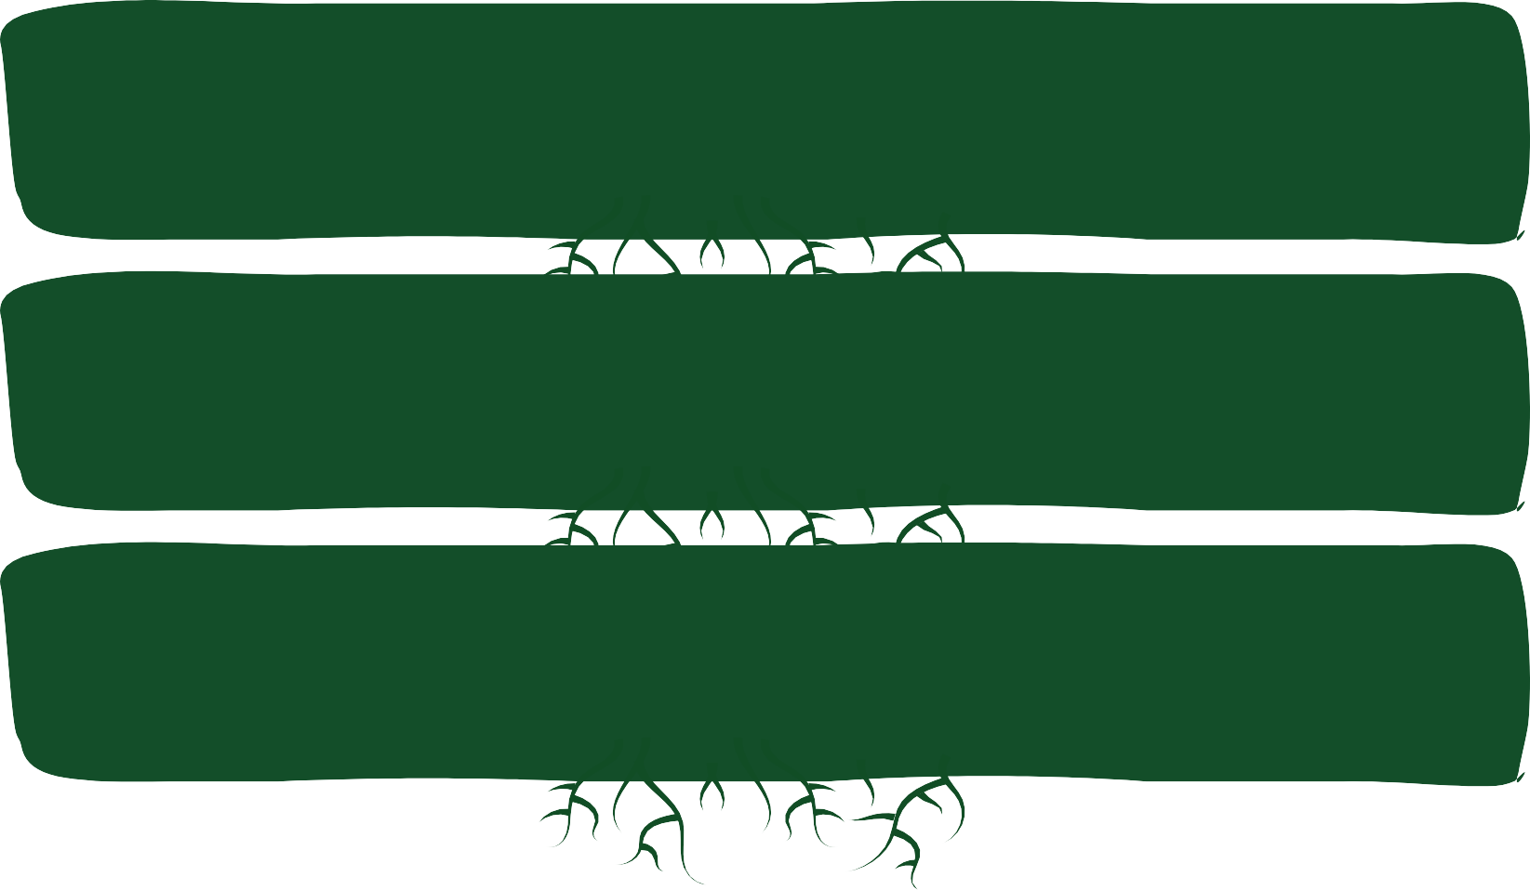


Let’s explore the etymology…
Base muse, meaning “music, song, or inspiration”, came from the Greek root Mousa, the name of a Greek goddess.
You will also see it in words like museum.
muse ic
Base electr came from the Greek root ēlektron, meaning “amber”, because rubbing amber produces static electricity, which was discovered in ancient times.
electr ic
Base mage came from the Greek root magos, meaning “sorcery or learned”.
mage ic
grammarsaurus.co.uk

Slide 56




When a stem ends in the the suffix –ic, we can add the suffix –an with the connecting vowel letter i to show a “person with the skills” of the the stem.
Can you solve the word sums?
music i
*CVL
an =
electric
i an =
*CVL
magic
i an =
*CVL
*connecting vowel letter
grammarsaurus.co.uk

Slide 57






How did you do?
music
i an =
musician
*CVL
electric
i an =
electrician
*CVL
magic
i an =
magician
*CVL
*connecting vowel letter
grammarsaurus.co.uk

Slide 58


Let’s add suffix -ic to some more bases to create stems.
opt ic
Can you solve the word sums to write these stems?
cline ic
physe ic
grammarsaurus.co.uk

Slide 59
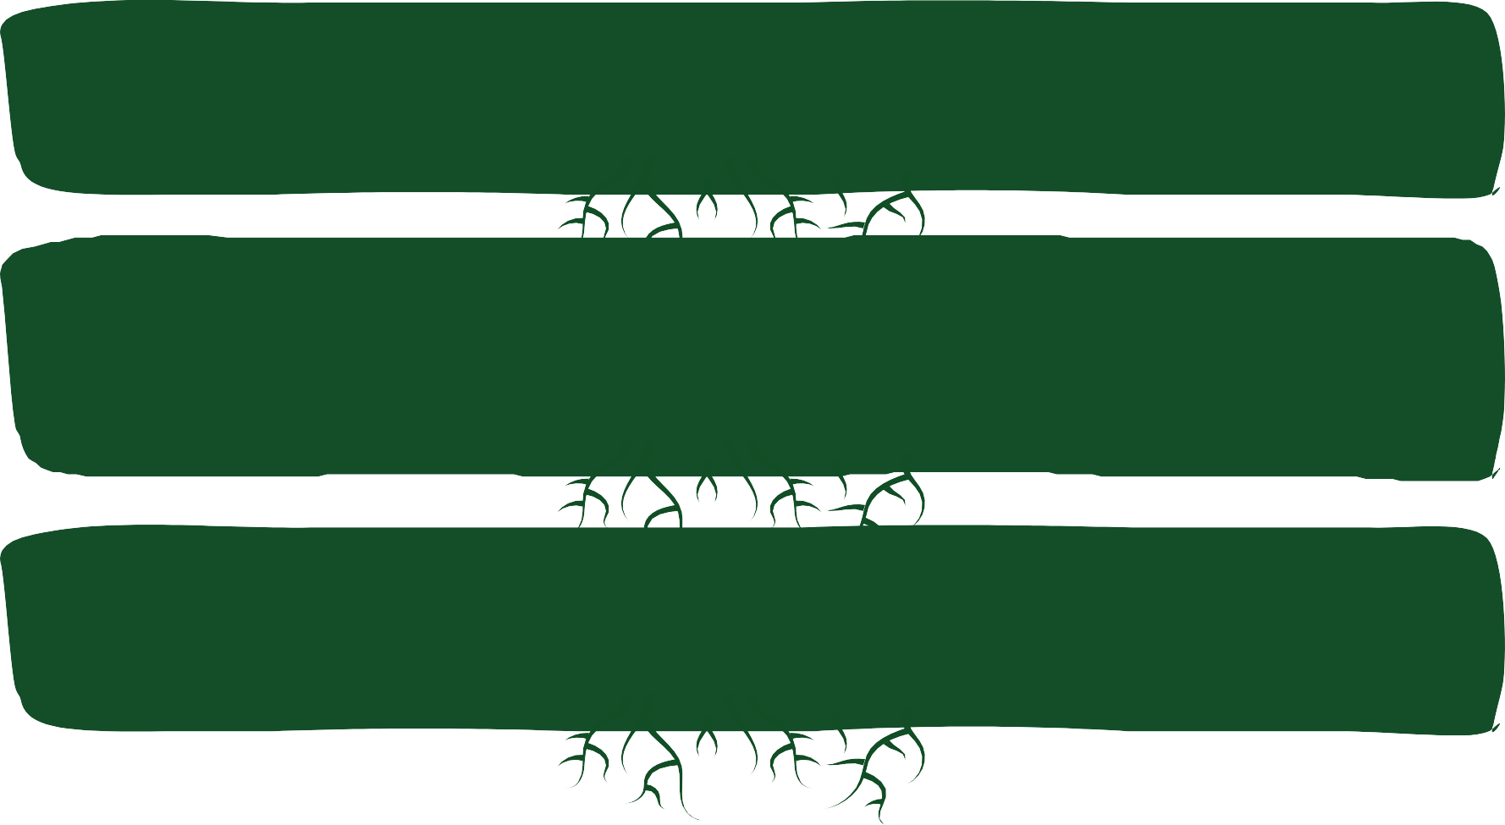

Let’s explore the etymology of these stems.
The base opt came from the Greek root optos meaning “eye or see”.
Combining base opt with suffix -ic forms a word for something related to the eyes or sight.
optic
The base cline came from the Greek root kline meaning “bed, couch, or a thing to lie on”. Adding the suffix -ic forms a word that relates to a bed or a couch. Traditionally, when you visited a clinic, you would lie on a bed to be treated.
clinic
The base physe comes from the Greek root phyein meaning “bring forth, produce, or make grow” and later “nature”. When base physe combines with suffix -ic, it forms a word related to the natural science of healing.
physic
grammarsaurus.co.uk

Slide 60




When a stem ends in the the suffix –ic, we can add the suffix –an with the connecting vowel letter i to show a “person with the skills” of the the stem.
Can you solve the word sums?
optic i
an =
*CVL
clinic
i an =
*CVL
physic
i an =
*CVL
*connecting vowel letter
grammarsaurus.co.uk

Slide 61







optician
How did you do?
optic
i an =
*CVL
These stems with the suffix –an tell us a person has the “skills” of that stem.
clinician
clinic
i an =
*CVL
i an =
physician
physic
*CVL
*connecting vowel letter
grammarsaurus.co.uk

Slide 62
Take a look at this stem with the suffix –an.
Thinking about what we have been learning, can you break it down into a word sum?
beautician
grammarsaurus.co.uk

Slide 63


How did you do?
beaut ic
i an
*CVL
Did you spot the connecting vowel letter i before the suffix -an?
*connecting vowel letter
grammarsaurus.co.uk

Slide 64





Let’s explore the etymology…
beaut ic i an
*CVL
The word beautician is built from base beaut meaning “person or thing of beauty”. It combines with suffix -ic which adds a sense of “related to or like” followed by a connecting vowel letter i to smooth pronunciation before suffix -an meaning a “person with a skill, belief, or linked to”. A beautician is a person with skills related to creating beauty in a person or thing.
The beautician painted my sister’s nails.
*connecting vowel letter
grammarsaurus.co.uk

Slide 65




Let’s take a closer look at base beaut...
Base beaut has been formed by shortening, or clipping, the word beauty.
beau
“pretty, handsome or charming”
free base beaut
ty = beauty
“state, quality or concept”
“person or thing of beauty”
The idea of going for a picnic was a beaut!
We can use base beau to build some words, and we can use base beaut to build other words. We can also use stem beauty to build new words.
grammarsaurus.co.uk

Slide 66






Let’s create some new words by combining stem beauty with other suffixes.
Can you solve the word sums?
What suffixing convention will you need to use when you add the suffix -ful to the stem beauty?
beauty ful
beauty ful ly
Can you use these words correctly in these sentences?
She sang the song .
The flowers look in the garden.
grammarsaurus.co.uk

Slide 67





How did you do?
Did you remember to change the final letter y after the consonant letter to i, then add the suffix -ful?
i
beautiful
beauty ful
=
beauty^{i} ful
ly = beautifully
She sang the song beautifully .
adverb
The flowers look beautiful in the garden.
adjective
grammarsaurus.co.uk

Slide 68
4
-ous
full of
grammarsaurus.co.uk
Latin Greek
Old English
wiitthh
grammarsaurus.co.uk

Slide 69
per-
completely, thoroughly or through
grammarsaurus.co.uk
Latin Greek
Old English
wiitthh
grammarsaurus.co.uk

Slide 70
sub-
under
grammarsaurus.co.uk
Latin Greek
Old English
wiitthh
grammarsaurus.co.uk

Slide 71
tract
pull or drag
Latin Greek
Old English
grammarsaurus.co.uk
wiitthh
grammarsaurus.co.uk

Slide 72
auto
self
grammarsaurus.co.uk
Latin Greek
Old English
wiitthh
grammarsaurus.co.uk

Slide 73
-ion
act or
process
grammarsaurus.co.uk
Latin Greek
Old English
wiitthh
grammarsaurus.co.uk

Slide 74
-an
person with a skill,
belief or linked to
Latin Greek
Old English
with
grammarsaurus.co.uk
with
grammarsaurus.co.uk

Slide 75


We have been learning how we can add the suffix -an to lots of bases.
Sometimes, a stem ending in suffix -ic can be followed by a connecting vowel letter i then suffix -an, like in the word…
musician
muse ic i an
*CVL
Chat to your partner. Can you remember what base muse means?
Can you think of any other stems where you might see it?
*connecting vowel letter
grammarsaurus.co.uk

Slide 76
Can you box the base of this stem ending in the suffix –an?
dietician
grammarsaurus.co.uk

Slide 77

How did you do?
dietician
The base diet means “way of life or routine”. Now let's break the word dietician into a word sum.
grammarsaurus.co.uk

Slide 78


We know that the base diet means “way of life or routine”.
diet ic i an
*CVL
A dietician is a person skilled in helping people keep a healthy way of life.
*connecting vowel letter
grammarsaurus.co.uk

Slide 79
Can you box the base of this stem ending in the suffix –an?
technician
grammarsaurus.co.uk

Slide 80
How did you do?
technician
The base techn means “art, craft, or skill”. You might recognise this base in other words.
grammarsaurus.co.uk

Slide 81






Can you complete these word sums with the base techn?
techn o
loge y ique
ic al
The base loge means “speak, gather or tell”.
*CVL
techn techn
The suffix –ique is from French and carries the same meaning as the suffix -ic.
*connecting vowel letter
grammarsaurus.co.uk

Slide 82





How did you do?
technology technique technical
Did you remember to drop the final silent e from the base loge before you added the suffix –y to make a noun?
Each stem carries the meaning of base techn, an “art, craft or skill”.
grammarsaurus.co.uk

Slide 83
Thinking about what we have been learning, can you break this word down into a word sum?
technician
grammarsaurus.co.uk

Slide 84

How did you do?
techn ic i an
*CVL
A technician is a person with skills in practical or mechanical arts and crafts.
*connecting vowel letter
grammarsaurus.co.uk

Slide 85
Can you box the base of this stem ending in the suffix –an?
politician
grammarsaurus.co.uk

Slide 86



How did you do?
From the spelling of the adjective polite, we might think it could be related to the word politician. But if we look deeper, we can see the word polite actually comes from a different root and carries a different meaning. In this case, it comes from the Latin root polire, which means “polish or make smooth”. So when someone is being polite, they are showing “polished behaviour”.
politician
In politician, the base pole comes from the Greek root polis meaning “city”.
Now, let’s break this word down into a word sum.
grammarsaurus.co.uk

Slide 87




How did you do?
pole it ic i an
*CVL
A politician is a person “linked to” public affairs in the city, what we would describe today as the government.
*connecting vowel letter
grammarsaurus.co.uk

Slide 88
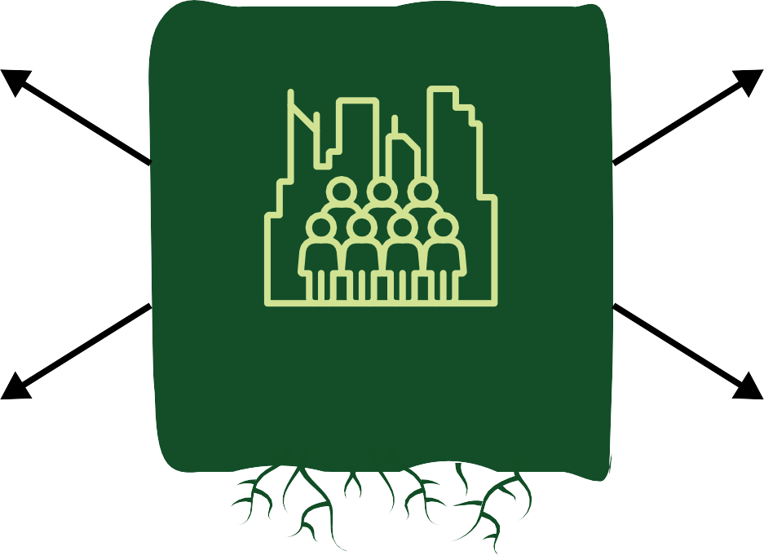
Can you spot the base pole in these words? How is the idea of “city” connected in each of their meanings?
metropolitan policy
pole
cosmopolitan
police
grammarsaurus.co.uk

Slide 89
Can you match each word to a meaning?
policy
A person who feels at home in cities around the world.
cosmopolitan
A plan, rule, or strategy adopted by a government
or organisation.
police
A major city and its surrounding communities.
metropolitan
The people in charge of maintaining public order and enforcing laws in the city or community.
grammarsaurus.co.uk

Slide 90

How did you do?
policy
A person who feels at home in cities around the world.
cosmopolitan
A plan, rule, or strategy adopted by a government
or organisation.
police
A major city and its surrounding communities.
metropolitan
The people in charge of maintaining public order and enforcing laws in the city or community.
grammarsaurus.co.uk

Slide 91






Welcome to the careers office.
We have many potential applicants looking for new roles.
Meet Ian. He is very crafty and skillful in mechanics.
Meet Lilian. She is very talented in making things pretty, like hair and nails. Meet Christian. He has a lot of experience in studying how the eyes work.
Meet Sian. She has studied natural science at university.
Meet Julian. He is very skilled in playing the guitar and he also sings.
Meet Adriana. She has strong beliefs in how to improve the government.
What role do you think might suit each applicant?
grammarsaurus.co.uk

Slide 92




We would like to congratulate you on your new roles.
Ian
Christian
Julian
technician
optician
musician
Lilian
Sian
Adriana
beautician
physician
politician
grammarsaurus.co.uk

