Slide 1


with
Base aut
Stem auto

Slide 2




review
challenge
partner talk
check
introduce
say
write

Slide 3


-ous
1
full of
grammarsaurus.co.uk
Latin Greek
Old English
wiitthh
with

Slide 4
per-
completely, thoroughly or through
grammarsaurus.co.uk
Latin Greek
Old English
wiitthh
with

Slide 5

sub-
under
grammarsaurus.co.uk
Latin Greek
Old English
wiitthh
with

Slide 6
tract
pull or drag
Latin Greek
Old English
wiitthh
grammarsaurus.co.uk
with

Slide 7




auto
self
grammarsaurus.co.uk
Latin Greek
Old English
wiitthh

Slide 8


The base aut comes from the Greek root autós meaning “self”.
The base aut usually combines with other bases to form compounds.
In words of Greek origin, the connecting vowel letter (CVL) o is often needed to smooth pronunciation between the bases of a compound when the word is spoken aloud.
auto
For this reason, base aut is commonly followed by the CVL o when combining with another base, so our flashcard features stem auto as a visual reminder of how it usually appears in English words.
auto
(stem)
aut o
‘self’
(base)
(*CVL)
self
grammarsaurus.co.uk
Latin Greek
Old English
wiwitthh
Connecting vowel letters (CVLs) are single-lettered morphemes used to join other morphemes to smooth pronunciation.

Slide 9
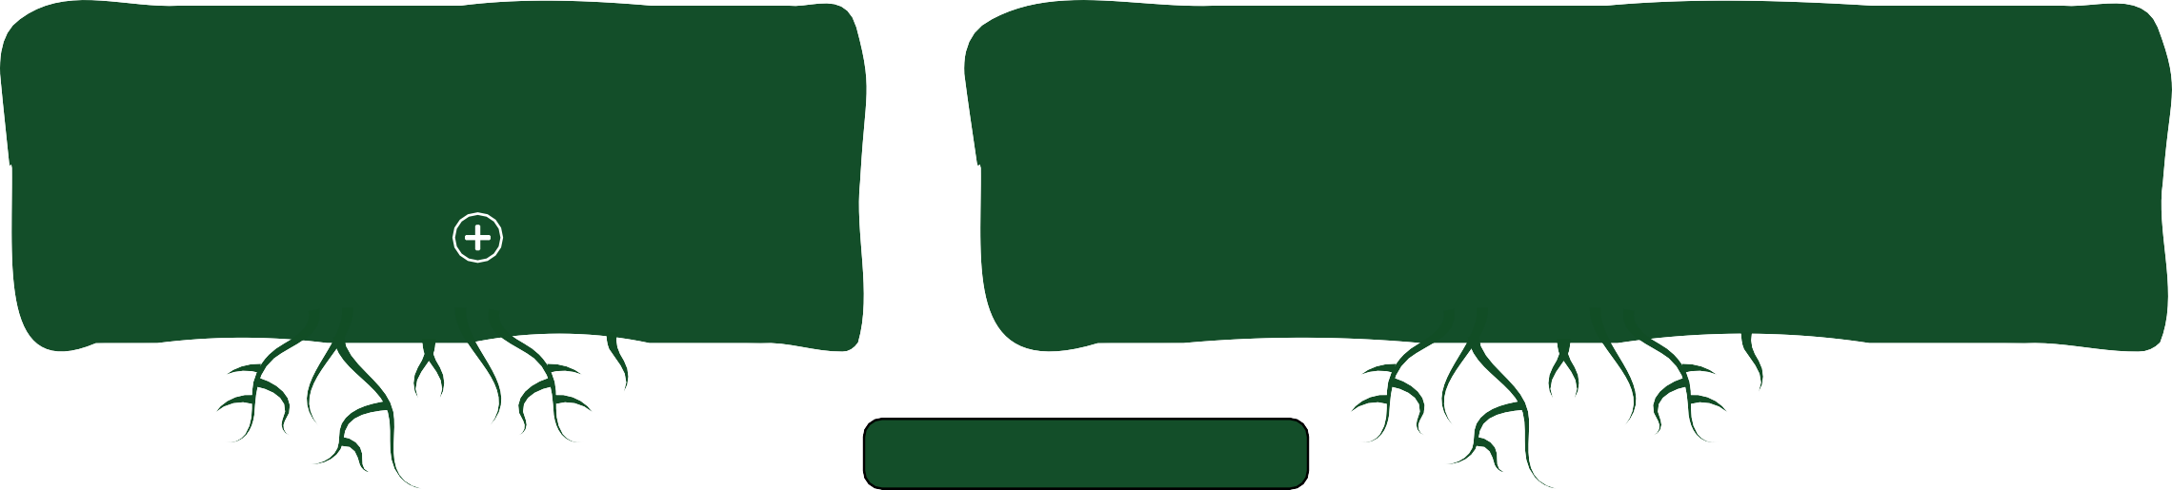
auto
Most commonly used words with the base aut are combined with the connecting vowel ‘o’, so we are going to focus on words with the stem auto.
The base aut and the connecting vowel ‘o’ form a stem: aut o = auto.

Slide 10
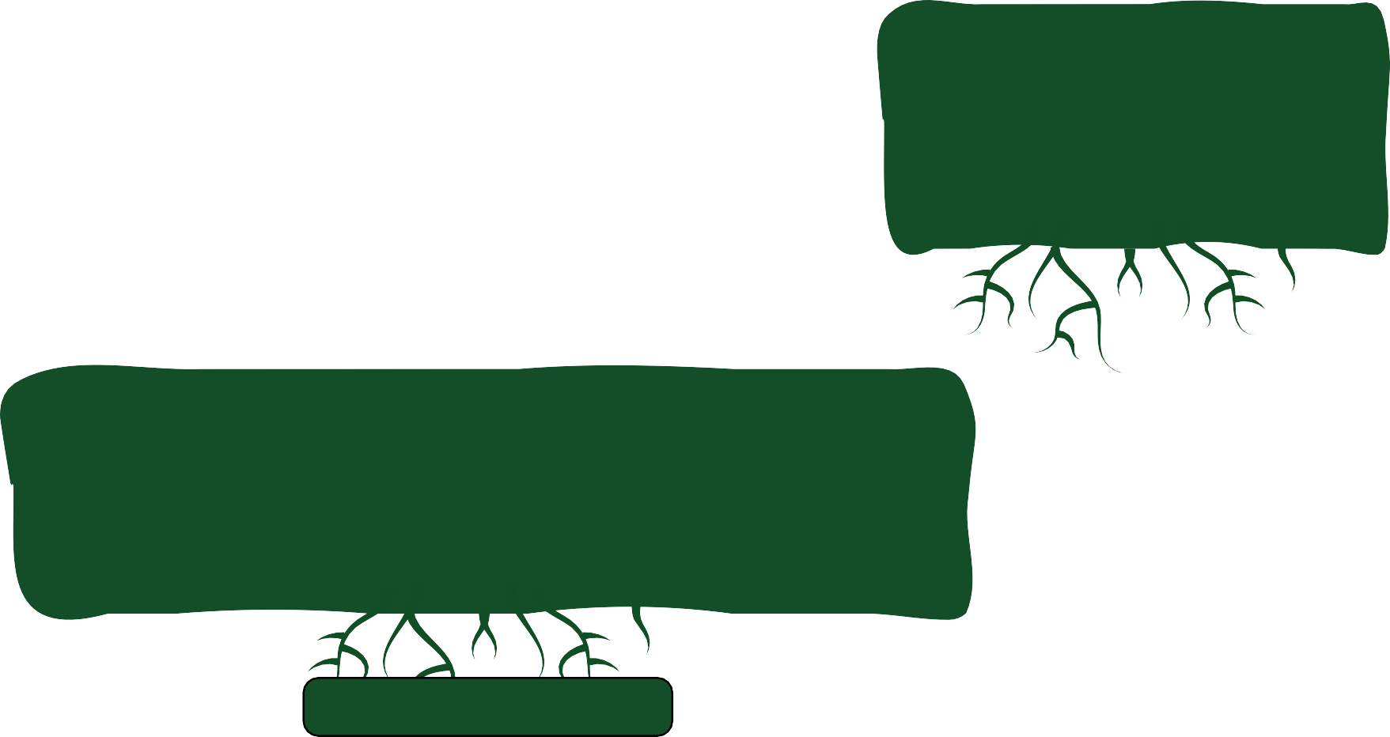


The stem auto
Greek origin.
is often combined with other morphemes of
This forms the compound autograph.
aut o graph = autograph.
*CVL
Free base graph comes from the Greek root graphein meaning write or draw.
*connecting vowel letter

Slide 11
Chat with your partner. Can you think of any words that you already know that contain the stem auto?
auto

Slide 12






How did you do?
autodial
autofocus
autosave
autotune
automobile
auto
autocorrect
autopilot
autograph
autobiography
automatic
autocrat
autonomy
Remember, a stem is a word part that includes at least a base, and may also include other morphemes. A stem is the word part we build onto.
The stem auto can be built onto without making any spelling changes.

Slide 13
Look at some of the words with the stem auto. Can you match them to their meaning?
autobiography
to call automatically
a book a person writes about their own life
automobile
a system that steers a ship, plane, or spacecraft by itself, without a person
autopilot
autodial
a usually four wheeled vehicle (car)

Slide 14




How did you do?
autobiography
to call automatically
Doing something ‘on autopilot’ also means to do something without thinking about what is happening.
a book a person writes about their own life
automobile
a system that steers a ship, plane, or spacecraft by itself, without a person
autopilot
Remember that mobile means movement. A mobile phone can be moved about freely.
autodial
a usually four wheeled vehicle (car)

Slide 15
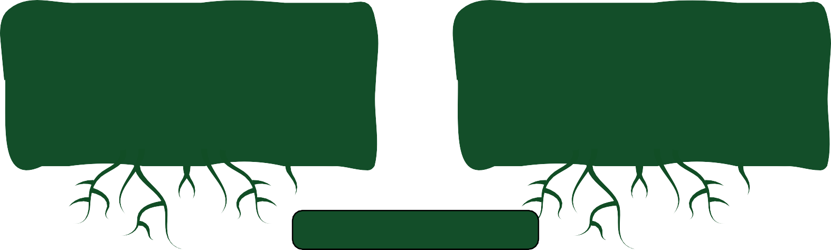
Take a look at this word…
biography
How many morphemes does it have?
What does each morpheme mean?

Slide 16









How did you do?
We can use the morphemes from the word biography to build other related words. We will look at this in another lesson.
It has four morphemes.
Remember, CVLs are considered morphemes.
bi o graph y
Fixing suffix -y to a base or stem changes it to a noun relating to something that is written or drawn.
*CVL
Like our base aut, the base bi (meaning life) also uses the connecting vowel ‘o’.
We know from looking at autograph that the free base graph is from a Greek root meaning write or draw.
*connecting vowel letter

Slide 17
Let’s practise spelling these words.
The words pilot and mobile are built from free bases. Biography and dial are built from combinations of bases and affixes.
biography
pilot
mobile
dial

Slide 18
o
Can you use the clues to solve the word sums?
o
=
=
*CVL
*CVL
o
o
=
=
*CVL
*CVL
*connecting vowel letter

Slide 19


o
How did you do?
= autobiography
o
= autopilot
*CVL
*CVL
o
= automobile
o
= autodial
*CVL
*CVL
In the word automobile, do you notice a change in pronunciation when we build onto stem auto?
*connecting vowel letter

Slide 20

crat
Let’s look more closely at the etymology of the bound bases used with the stem auto.
autocrat
The bound base crate comes from the Greek root Kratos meaning “power or rule”. When base crate is in the final position of a word, it doesn’t take on a final silent e. But when a vowel suffix is added, the final silent e is kept to prevent the final t from doubling.
An autocrat is often someone who exercises absolute “control” and “authority” (usually over a country).
The young queen was an autocrat who made every decision alone.

Slide 21

nome y
Let’s look more closely at the etymology of the bound bases used with the stem auto.
autonomy
The bound base nome comes from the Greek root nomos, meaning “custom or regulation”.
Autonomy is the “ability or right” of an individual or group to make decisions independently, without being controlled by others.
The young prince wanted more autonomy so he asked to make his own choices instead of always following royal rules.

Slide 22
mate ic
Let’s look more closely at the etymology of the bound bases used with the stem auto.
automatic
The bound base mate comes from the Greek root matos, meaning “move or act”.
Automatic refers to something that “works” or ”operates” without the need for human intervention or control.
The car has automatic windows that roll up and down with the push of a button.

Slide 23

autodial
Let’s look more closely at the etymology of the bound bases used with the stem auto.
(stem)
di al
The bound base di comes from the Latin root dies, meaning “day”. Combined, these morphemes form the stem dial. This links back to sundials, which were devices that showed the passing of time from the position of the sun's shadow on its round face during the day. Old fashioned phones had a numbered dial, and the face of an analogue clock is still called a dial today!
To autodial means to make a phone call automatically, without needing to press the numbers yourself. A computer program or app does it for you.
Mum uses her car’s hands-free system to autodial Dad.

Slide 24


Let’s look again at some of the words with the stem auto.
Some of them are fixed to a bound base and some to a free base.
stem auto | bound | free
automatic
automobile
autopilot
autonomy
autocrat
autodial
Can you sort these words according to whether they contain a bound or free base?

Slide 25


How did you do?
stem auto | bound | free
automatic
automobile
autopilot
autonomy
autocrat
autodial

Slide 26

Auto or Not-o?
We’re going to play a quick game as a class.
Let’s look at the words on the cards and decide if they are real or not.
Auto = Yes Not-o = No

Slide 27

auto
We have looked at how the stem auto, which means “by itself” or “oneself”, can combine with both free and bound bases.
self
grammarsaurus.co.uk
Latin Greek
Old English
wwiitthh

Slide 28
-ous
2
full of
grammarsaurus.co.uk
Latin Greek
Old English
wiitthh
with

Slide 29
per-
completely, thoroughly or through
grammarsaurus.co.uk
Latin Greek
Old English
wiitthh
with

Slide 30
sub-
under
grammarsaurus.co.uk
Latin Greek
Old English
wiitthh
with

Slide 31
tract
pull or drag
Latin Greek
Old English
wiitthh
grammarsaurus.co.uk
with

Slide 32
auto
self
grammarsaurus.co.uk
Latin Greek
Old English
wiitthh

Slide 33

BREAKING NEWS…
Yesterday, an automatic automobile crashed whilst in autopilot mode!
Can you spot the words we’ve already looked at with stem auto? How are they all connected in meaning?

Slide 34



Yesterday, an automatic automobile crashed whilst in autopilot mode!
These words all describe something that can self-move when we build onto the stem auto.
The noun automobile can sometimes just be shortened to auto but we usually just say car.

Slide 35


Imagine you are a newsreader using an autocue. Read them out and work out the missing compounds.
Autocue is a brand name now commonly used as a synonym for a teleprompter. It tells newsreaders what they need to say!
Here are today’s top stories…
In the music world, a famous singer admitted to using in their latest song.
A fantastic feature is being added to school computers to make life easier. An amazing phone update includes an feature for emergencies.
A camera with a new type of is making photography easier!
autofocus
autodial
autosave
autotune

Slide 36
How did you do?
Autocue is a brand name now commonly used as a synonym for a teleprompter. It tells newsreaders what they need to say!
Here are today’s top stories…
In the music world, a famous singer admitted to using autotune in their latest song.
A fantastic autosave feature is being added to school computers to make life easier. An amazing phone update includes an autodial feature for emergencies.
A camera with a new type of autofocus is making photography easier!

Slide 37
aut o mobile aut
Can you add another morpheme to make these nouns plural
(more than one)?
-s
s =
-es
s =
s =
o bi o graph y es ⁼
*CVL
crat
graph
*CVL
aut aut
more than one or
_{Latin} present simple
Greek
Old English
tense
*CVL
grammarsaurus.co.uk
with
Will you need to make any changes to the spelling?
*CVL
*CVL
*connecting vowel letter

Slide 38
How did you do?
aut o mobile s ⁼ automobiles
aut
aut
aut
Did you remember to change the final letter y after a consonant letter to i? Then we needed to add the suffix -es to show more than one.
*CVL
crat
graph
s ⁼ autocrats
s ⁼ autographs
*CVL
*CVL
_{y}i
o bi o graph
es ⁼ autobiographies
*CVL
*CVL
*connecting vowel letter

Slide 39
Add the plural nouns into the correct sentence.
There were lots of at the car garage.
Some rule without people getting a vote.
The were now in the bookshop.

Slide 40
How did you do?
There were lots of automobiles at the car garage.
Some autocrats rule without people getting a vote.
The autobiographies/ were now in the bookshop.
(autographs)

Slide 41
Autograph(s) can function as a noun and a verb. Which is which? How do you know?
The author signs his autographs himself.
The author autographs every book himself.
The verb is being used in the present tense.

Slide 42
Let’s explore how the word autograph functions in each sentence.
The author signs his autographs himself. noun
The subject is the author.
The verb is signs.
The object (noun) is the autograph.
The author autographs every book himself. verb
The subject is the author.
The verb is autographs.
The object (noun) is book.

Slide 43

aut o focus ed ⁼ aut o graph ed aut o tune ed ⁼ aut o save ed ⁼ aut o dial ed ⁼
How do we change these verbs with the stem auto into the
past tense?
Do we need to make any changes when we add the suffix -ed?
*CVL
-ed
=
*CVL
*CVL
We will learn later that the stems focus and dial are built from a bound base and a suffix.
past simple
tense verbs or
*CVL
Latin Greek
past participles
wiwitthh
Old English
grammarsaurus.co.uk
*CVL
*connecting vowel letter

Slide 44
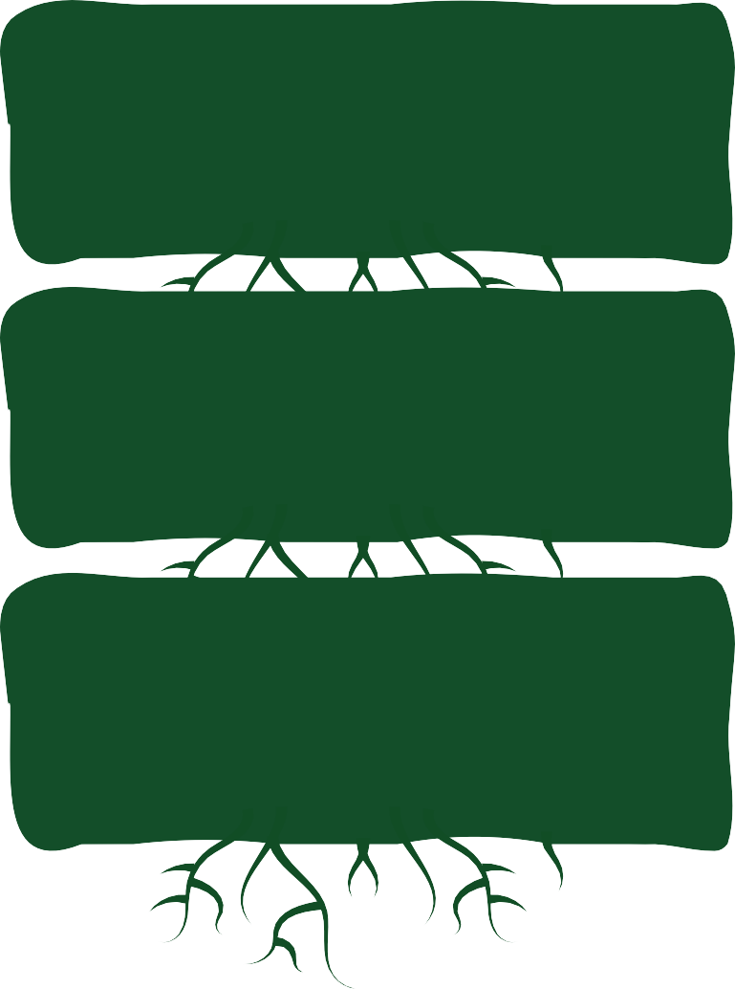










How did you do?
aut o focus
aut o graph
aut o tune
aut o save
aut o dial^{l}
ed ⁼ autofocused
ed ⁼ autographed
ed ⁼ autotuned
ed ⁼ autosaved
ed ⁼ autodialled
The final s in autofocus isn’t doubled because when we say the word, the stress doesn’t fall on the syllable preceding the suffix -ed.
*CVL
*CVL
Did you remember to drop the final silent e vowel letter in autotune and autosave before adding the vowel suffix -ed?
*CVL
*CVL
In British English, a verb’s final l following a single vowel letter is usually doubled before adding a vowel suffix.
*CVL
*connecting vowel letter

Slide 45
-ous
3
full of
grammarsaurus.co.uk
Latin Greek
Old English
wiitthh
with

Slide 46
per-
completely, thoroughly or through
grammarsaurus.co.uk
Latin Greek
Old English
wiitthh
with

Slide 47
sub-
under
grammarsaurus.co.uk
Latin Greek
Old English
wiitthh
with

Slide 48
tract
pull or drag
Latin Greek
Old English
wiitthh
grammarsaurus.co.uk
with

Slide 49


auto
So far this week, we have developed our understanding of using stem auto with free and bound bases.
We’ve also looked at adding additional morphemes to create plural nouns and verbs in different tenses.
self
grammarsaurus.co.uk
Latin Greek
Old English
wiitthh

Slide 50



Let’s try building some words from a new stem.
makes nouns (state, quality condition)
y
bi
o graph
*CVL
stem
biograph
*connecting vowel letter

Slide 51
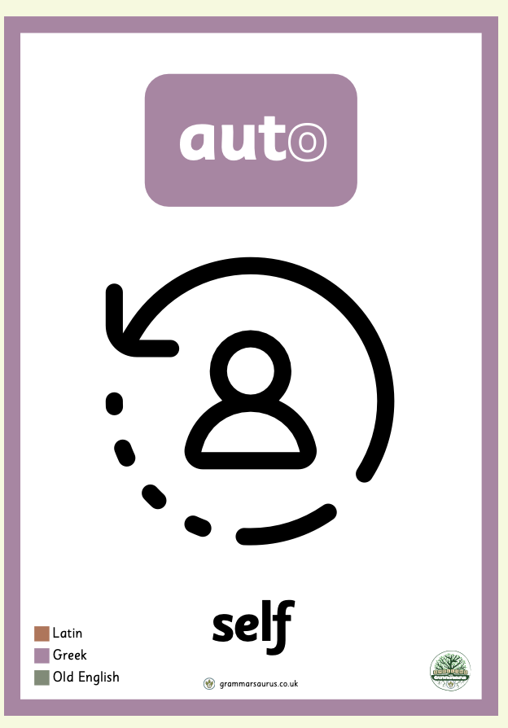
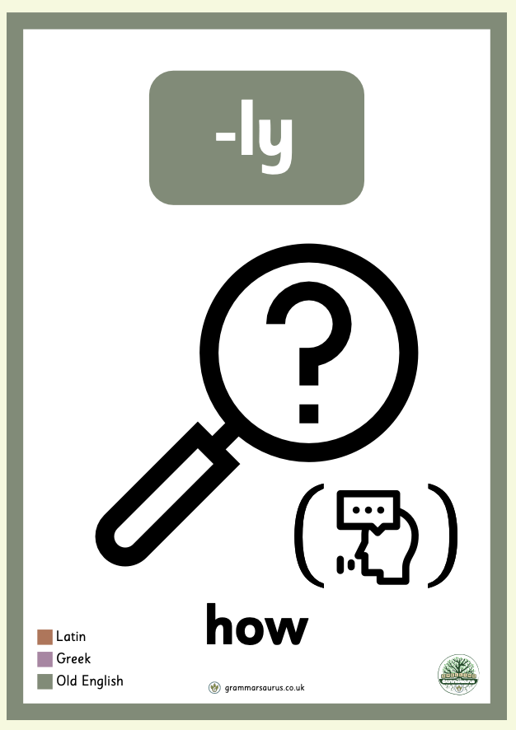


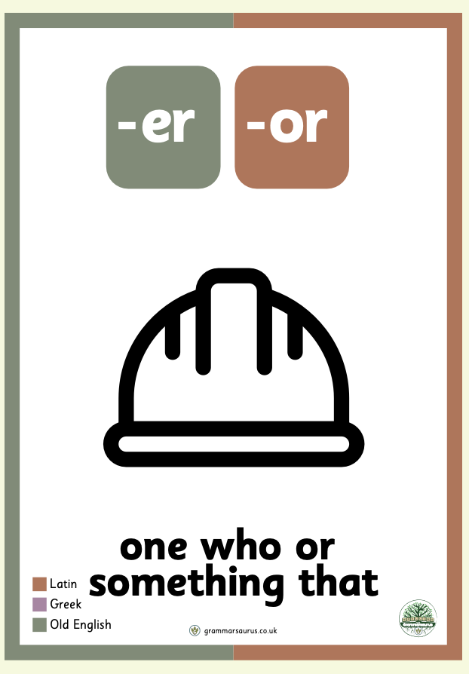
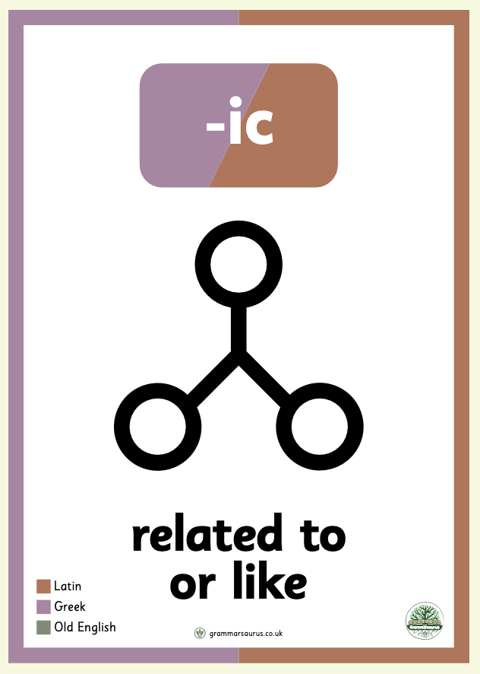
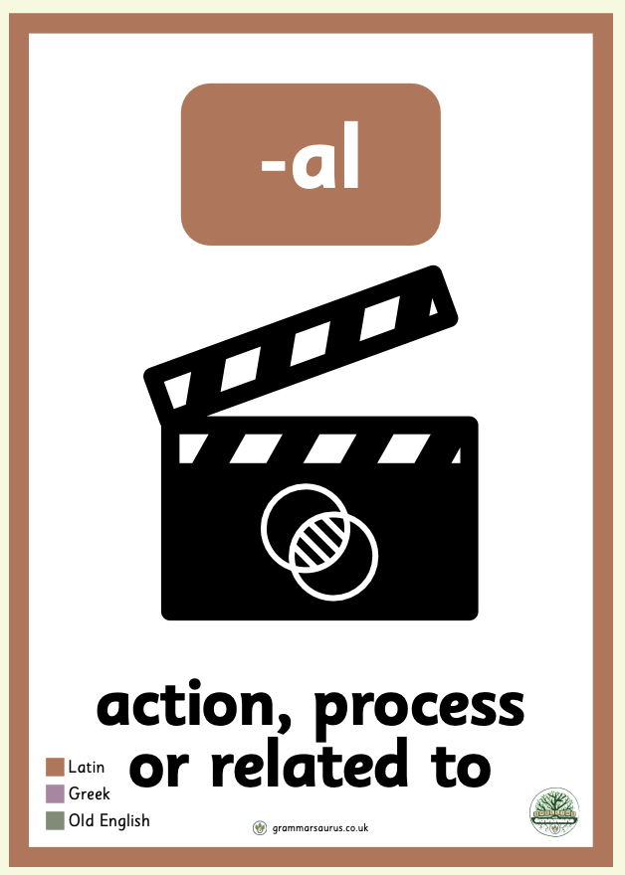
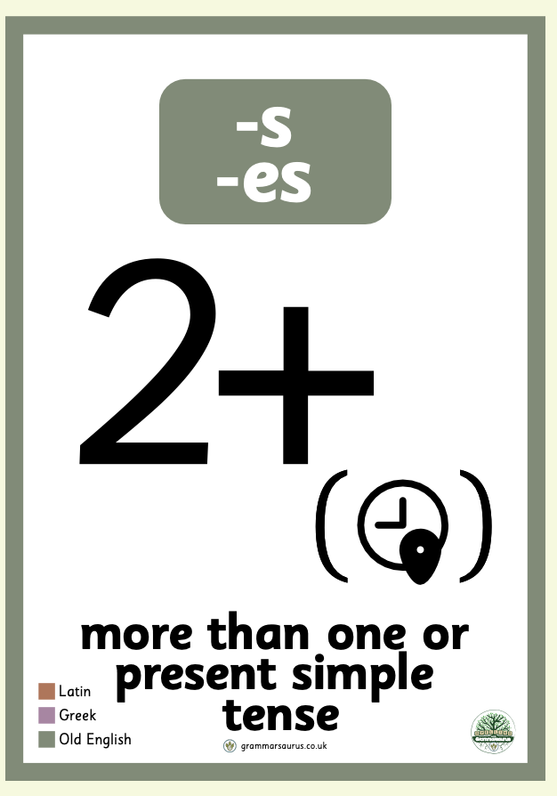


biograph
What words can we create from stem biograph with these other morphemes we know?
stem
bi o graph
We can also add suffix -y to this stem to make a noun.

Slide 52
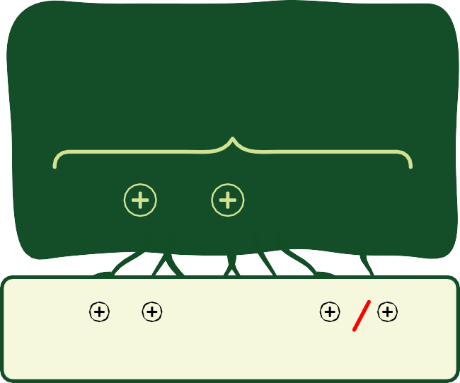


How did you do? What others did you come up with?
aut o biograph ic al ly autobiographically
aut o biograph y autobiography
biograph
_{y}i
es
biographies
aut o biograph er
autobiographer
biograph
stem
bi o graph
biograph er s biographers
biograph ic al biographical
Did you remember to change y to i, then add the suffix?
_{y}i
aut o biograph
es
autobiographies
grammarsaurus.co.uk

Slide 53







Let’s review some of the verbs we’ve looked at.
Using these verbs, what words can we build by adding onto the stem
auto?
save
focus
(stem)
foce us
correct
(stem)
cor rect
tune
dial
(stem)
di al
grammarsaurus.co.uk

Slide 54
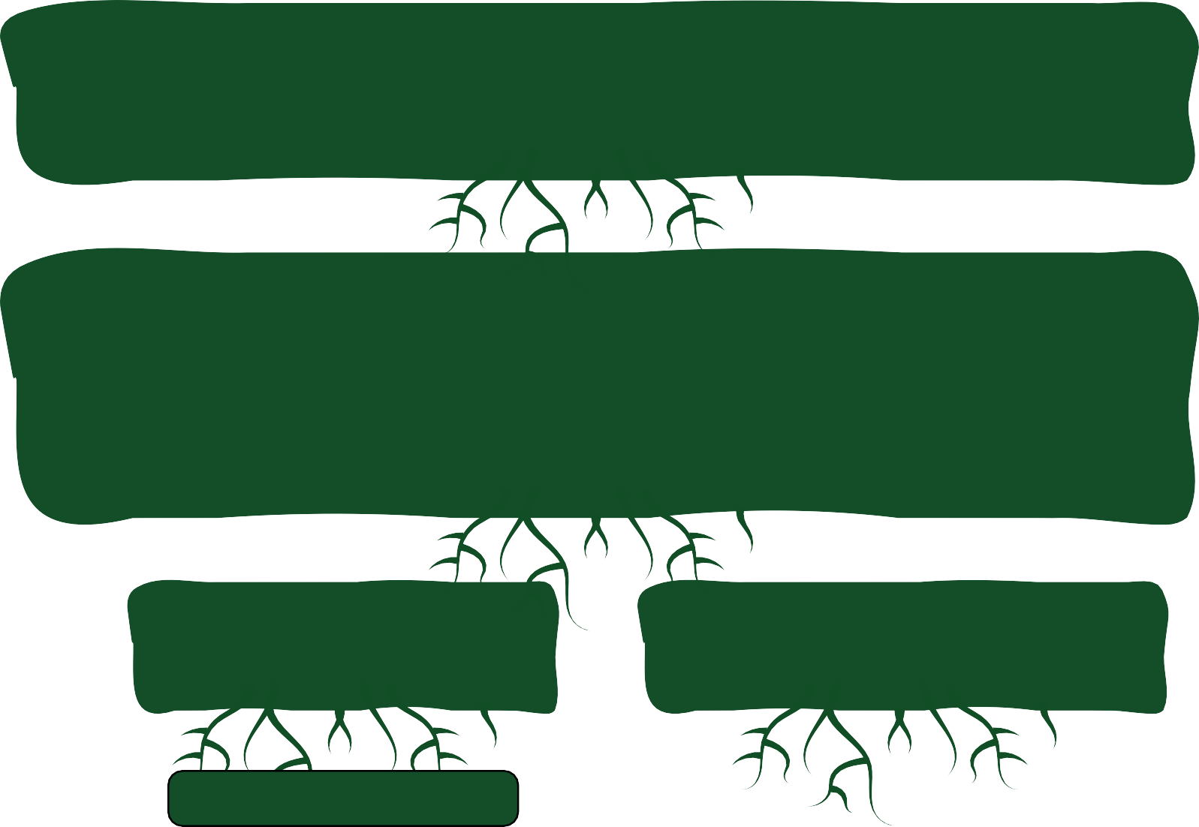
Solve these word sums by building onto the stem auto, using the verb icons.
o
Focus has been borrowed directly from Latin, and originally meant a
central point, like a hearth or fireplace, where a family might gather.
Focus has a bound base foce and a suffix -us.
*CVL
o
*CVL
Correct is also a combination of two morphemes.
The prefix cor- is a Latin assimilated form of prefix com-, meaning with or together. It’s combined with bound base rect, from the Latin root regere, meaning guide or make right. Together, they form correct, meaning make right together.
o
*CVL
o
*CVL
o
Do you need to make any spelling changes?
Remember, dial has a bound base di and a suffix -al.
*CVL
*connecting vowel letter

Slide 55
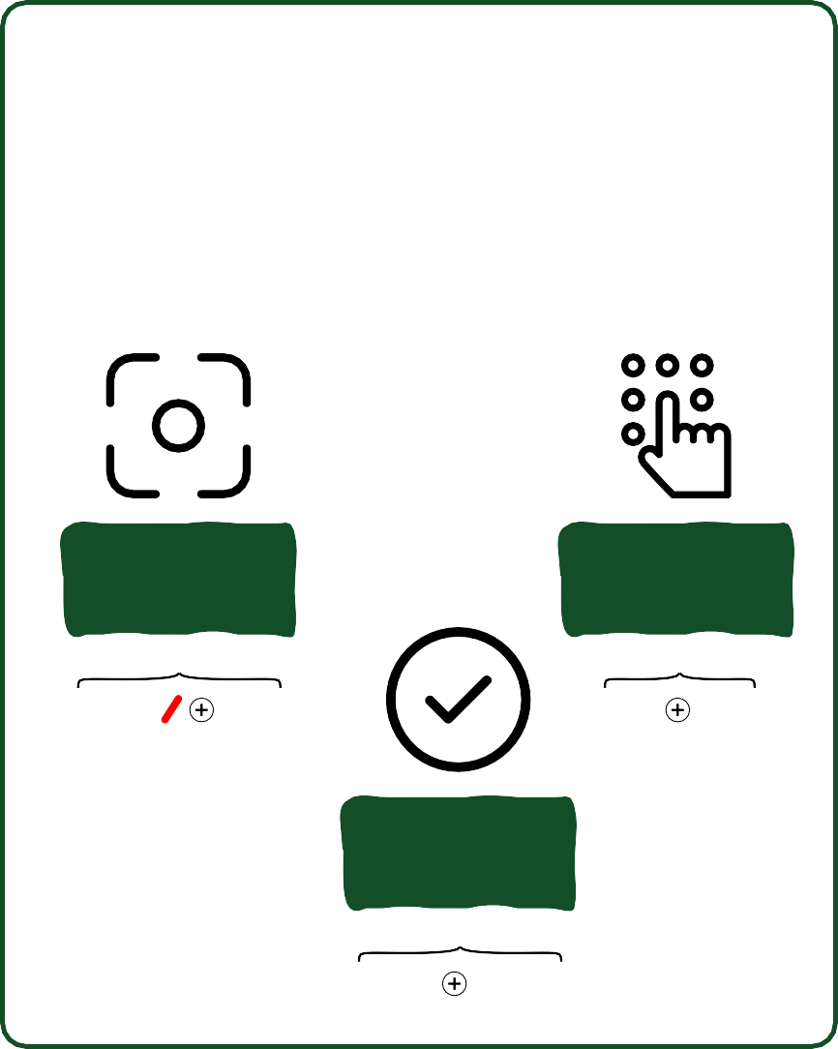
How did you do?
= aut
= aut
= aut
= aut
= aut
o
o o o o
dial focus correct save tune
o
We know that some of these verbs are stems so we can break down the morphemes further like this:
*CVL
o
*CVL
o
*CVL
o
focus
(stem)
foce us
dial
(stem)
di al
*CVL
o
correct
(stem)
cor rect
*CVL
*connecting vowel letter

Slide 56
How did you do?
= aut
= aut
= aut
= aut
= aut
o
o
o
o
o
o
di al
Did you remember to build dial, focus and correct using their bound bases?
*CVL
foce us cor rect save
tune
o
*CVL
o
*CVL
o
We need to drop the final silent e in foce before adding the vowel suffix -us.
*CVL
o
*CVL
*connecting vowel letter

Slide 57




aut
We know that the suffix -ed can indicate a verb is in its past tense. We also know that the suffix -ing can show that the action is continuing or in the present participle form.
o graph
= autographing
*CVL
He is autographing the book.
*connecting vowel letter

Slide 58
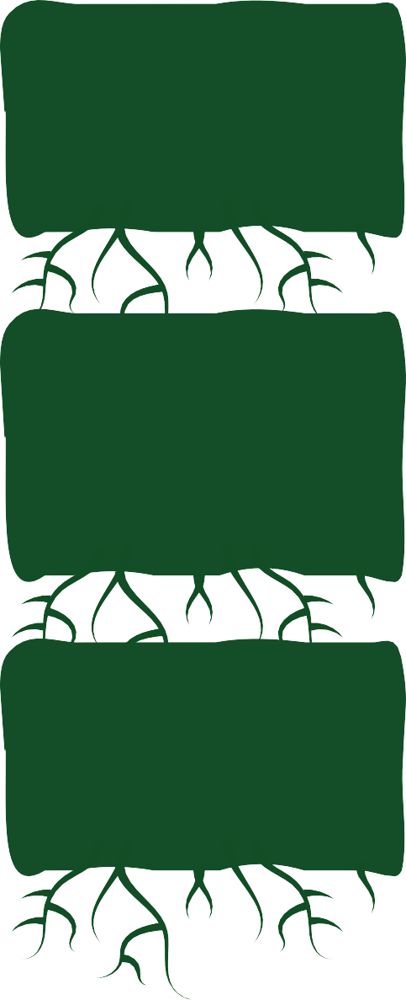






















How did you do?
In British English, a verb’s final l following a single vowel letter is usually doubled before adding a vowel suffix.
o
o di al^{l}
focus
= aut
ing = autodialling
*CVL
o
= aut
o
ing = autofocusing
*CVL
The final s in autofocus isn’t doubled because when we say the word, the stress doesn’t fall on the syllable preceding the suffix -ing.
o
= aut
correct ing = autocorrecting
save ing = autosaving
tune ing = autotuning
*CVL
o
= aut
*CVL
Did you remember to drop the final silent e vowel letter in foce, save and tune before adding their vowel suffixes?
o
= aut
*CVL
*connecting vowel letter

Slide 59


Let’s look at using the stem auto with the past progressive verb tense.
Sophie was autodialling the hotline all day to get concert tickets.
This means she started something in the past which continued.

Slide 60

Let’s practise using the past progressive tense. Use the stem icons as clues.
Sorry Miss, I couldn’t do my homework because…
The laptop was my work when suddenly, it was struck by lightning! My camera was when suddenly, a bear stole it!
My guitar was when suddenly, it exploded!
The computer program was when suddenly, aliens took it!
autofocusing
autotuning
autosaving
autocorrecting

Slide 61
How did you do?
Sorry Miss, I couldn’t do my homework because…
The laptop was autosaving/ my work when suddenly, it was struck by lightning! (autocorrecting)
My camera was autofocusing when suddenly, a bear stole it!
My guitar was autotuning when suddenly, it exploded!
The computer program autocorrecting/ when suddenly, aliens took it!
(autosaving)

Slide 62

Noughts and Crosses
In pairs, players take it in turns to read definitions of words to each other.
If they spell the word correctly, they then get to mark off a nought or a cross on their grid.

