Slide 1

Phonics Screening
Year 1 & 2
A guide for parents.

Slide 2
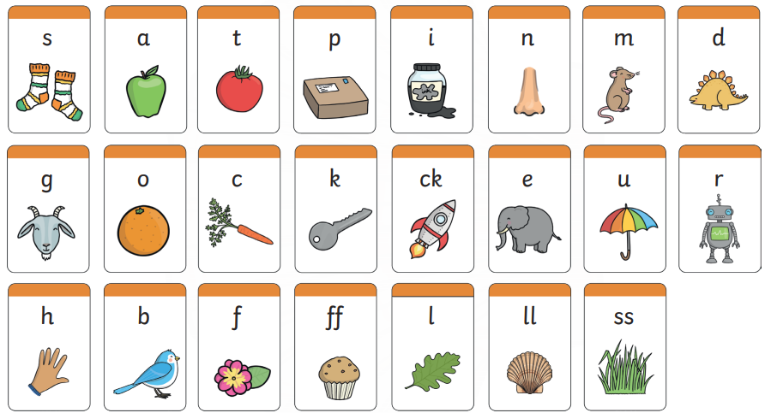
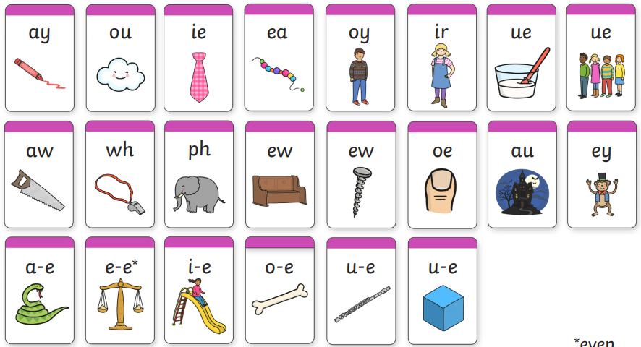
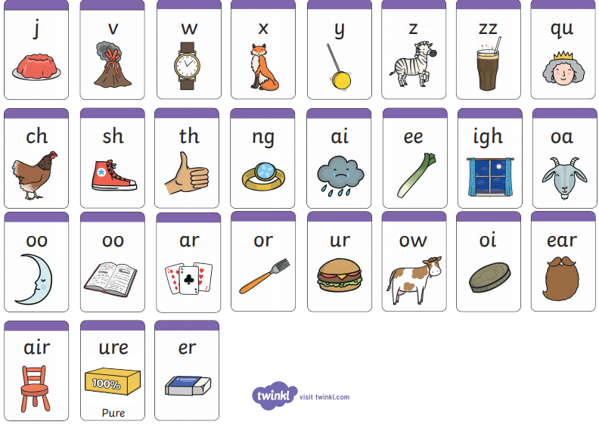
What is Phonics?
Children are taught to read by breaking down (segmenting) words into separate sounds or ‘phonemes’. They are then taught how to blend these sounds together to read the whole word.
Children in Foundation Stage and Key Stage 1 have a phonics lesson daily and they are encouraged to use these strategies to read and write in other lessons.

Slide 3
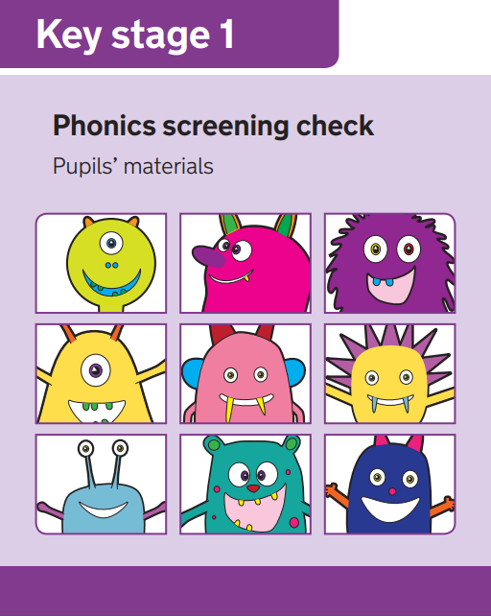
What is the aim of the check?
The purpose of the phonics screening check is to confirm that all children have learned phonic decoding to an age-appropriate standard and can apply their knowledge of grapheme/phoneme correspondences.
Children who have not reached this level will receive extra support in school to ensure they can improve their decoding skills.

Slide 4

When will the screening happen?
Every Year 2 child in the country will be taking the Phonics Screening Check in the second part of the Autumn term to make up for the missed check in June. This is likely to take place in December.
Those Year 2 children who don’t pass will be taking the check again later in the school year.
Likely to be in June 2021 when the year 1 children will sit their Screening Check .
The results will be reported to parents as part of the annual school report.

Slide 5
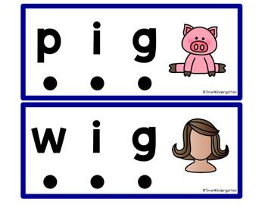
What do we expect children to do?
The check is very similar to tasks the children already complete during phonics lessons. We look at real words and alien words and children are able to differentiate between the two.
Children will be asked to ‘sound out’ a word and blend the sounds together, eg d-o-g - dog
The focus of the check is to see which sounds the children know
THIS IS NOT A READING TEST.
It is very important that children ‘show off’ their phonic knowledge and read every phoneme carefully!

Slide 6
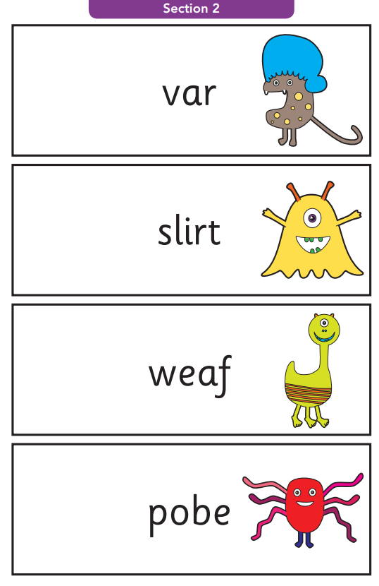
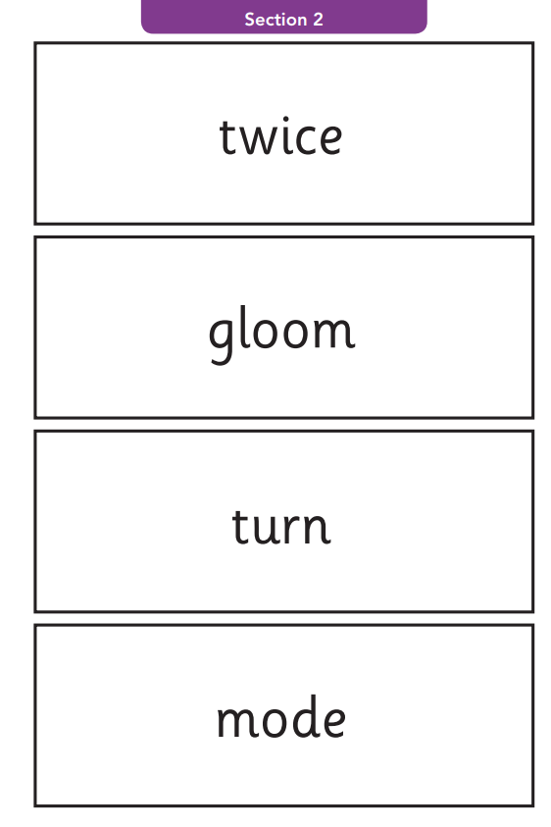
Example words
Alien/Pseudo words
Real words

Slide 7

How will the children complete the check?
The children will complete the check one at a time in a quiet area of the school (normally Mrs Moreton’s office).
The screening will only take 10-15 minutes with each child.
They will be told that they are going to ‘show off’ to Mrs Moreton how good they are at phonics and no pressure is applied to the children.

Slide 8
How can you help?
The way in which you learnt to read, is probably very different from the way we teach children to read now. If you attended a previous phonics information session you will have an idea of how we teach phonics.
If not here is a quick guide to some of the things you can do to help you child in preparation for the Screening Check.
Remind your child to look for the following when faced with an unfamiliar word (real or alien/pseudo)
  Look for any familiar digraphs first, then any trigraphs, then any split digraphs. What ever is left are single phonemes.
Encourage children to use sound buttons and robot arms when breaking the words down.
  A dot for a single phoneme, a small line for a digraph/trigraph and a hook for an split digraphs. These should all be placed under the letters in the word. (see next slide for information on sound buttons)
Play some online game
  Please see the Phonics section on the school website for links to online games.

Slide 9
Using sound buttons
We use sound buttons to help children recognise the different parts of a word. (single phonemes, digraphs, trigraphs and split digraphs)

Slide 10


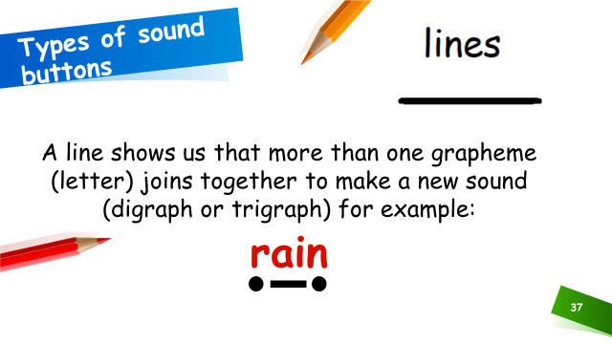
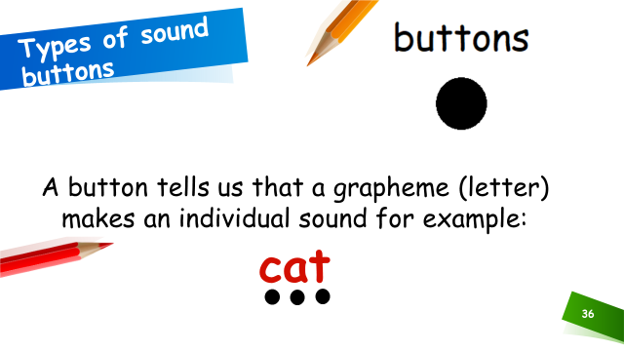
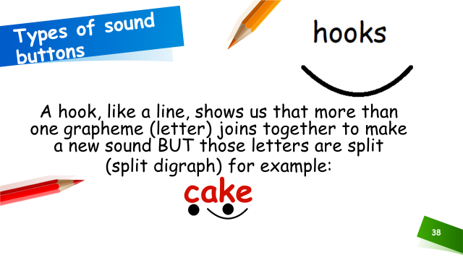
Using sound buttons

Slide 11
Useful websites
Teach your Monster to read
https://www.teachyourmonstertoread.com/
  Phonics Play:
https://www.phonicsplay.co.uk/InteractiveResources.htm
  YouTube – phoneme pronunciation:
https://www.youtube.com/watch?time_continue=18&v=UCI2mu7URBc&feature=emb_logo

Slide 12
Online Phonics Games
Click on the links below to access free phonics games.
Phonics Bloom
Education.com
Top Marks

Slide 13
Questions
If you have any questions regarding the Phonics Screening Check, please contact the school office and arrange to speak with your child’s class teacher.

Slide 14

Thank you
Thank you for your ongoing support

