Slide 1
Ways you can practice your spellings

Slide 2
ways to learn…
Look, say, cover, write, check

Slide 3
Segmentation
Split the words into their phonemes (sounds)
Shrimp
Sh – r – i – m – p

Slide 4
Quickwrite
Write as many words as you can starting with the phoneme sh in 1 minute…
On your marks, get set… GO

Slide 5
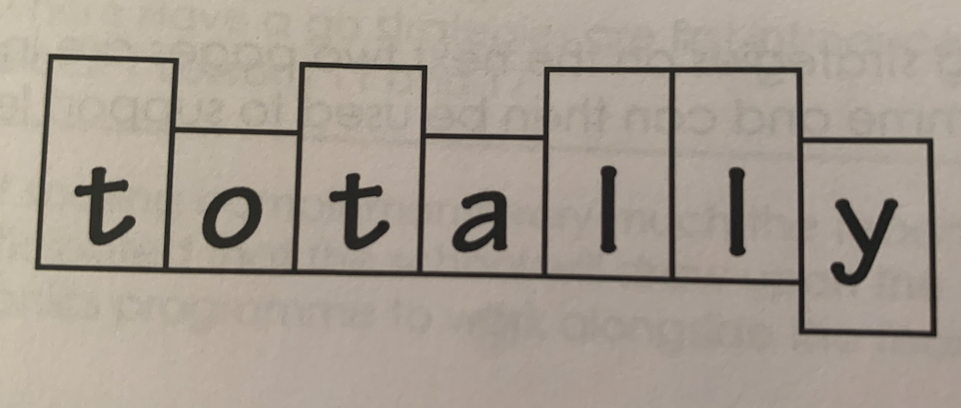
Draw around the letters
Totally

Slide 6
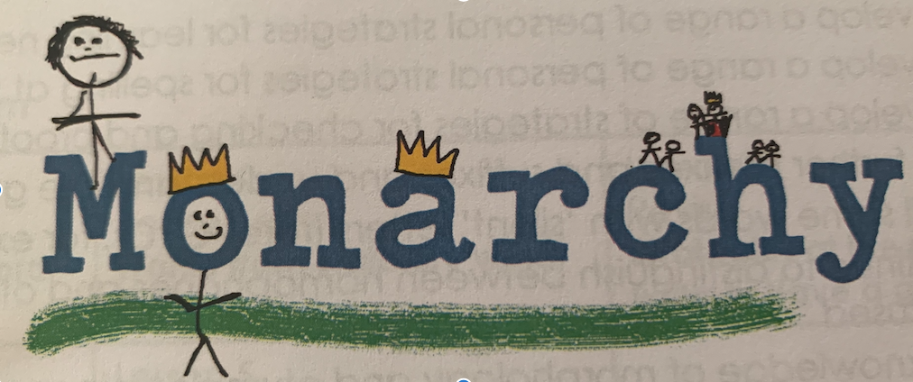
Draw a related image around the word
Monarchy

Slide 7
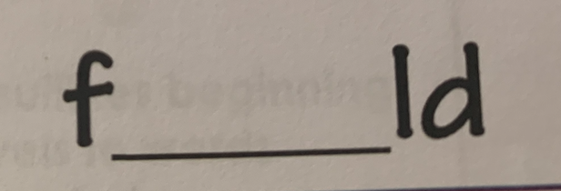
Words without the vowels
I’ll give you a word with the vowels missing… you choose the correct ones to put in the space!
Notes:
field

Slide 8
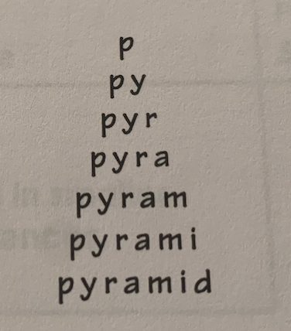
Pyramid

Slide 9
Rainbow writing
Use coloured pens and pencils to write the word in different ways. You could highlight the tricky bit, or segment it into its phonemes, or write each letter in a different colour…

Slide 10
Silly sentences:
Spot the statutory words:
The awkward secretary had a disastrous accident in her yacht – she fell overboard!

