Slide 1

Overview
London 2026
Itinerary
Safety measures
Uniform/What you need to bring
Expectations/behaviour
Questions
Reaching potential Rising to challenges Respecting all

Slide 2
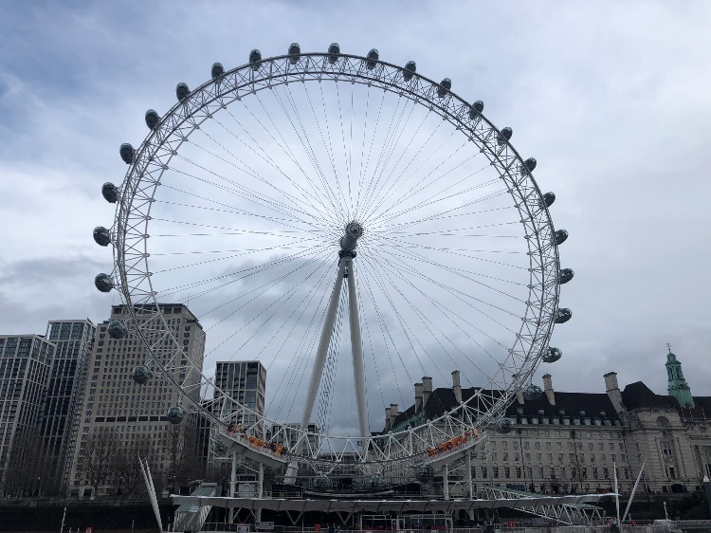
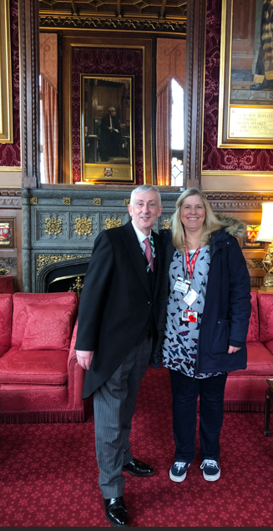
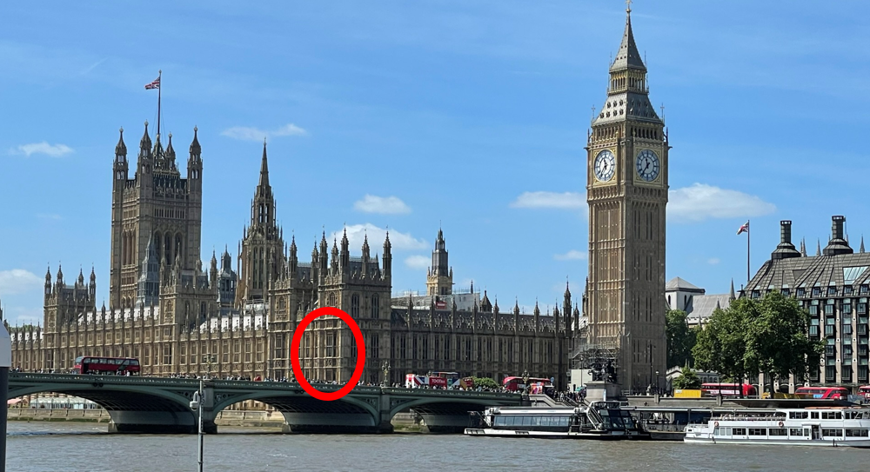
London 2026
Itinerary
7:45am Children to arrive at Preston Station – final details will follow
8:01am Depart Preston
10:14 am Arrive in London
River Cruise and eat lunch on the boat 45 mins cruise.
Session within Parliament plus met Sir Lindsay Hoyle
London Eye (approx. 30 mins session)
Tea at Great British Fish and Chips
6.30pm – Train back to Preston
Arrive 8.39pm
Reaching potential Rising to challenges Respecting all

Slide 3
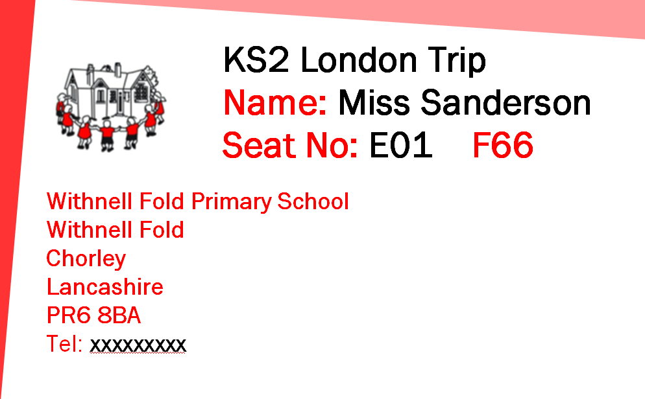
London 2026
Safety measures
Visit been approved by LCC Educational visits team
All children and staff wearing lanyards with details on
Children briefed about what to do should they get separated from an adult / the group
All visitors scanned on entry to Parliament
Reaching potential Rising to challenges Respecting all

Slide 4
London 2026
Uniform / What you need to bring
School uniform to be worn with trainers or similar shoes as we are walking round
Disposable lunch to eat on the River Cruise the less we take into Parliament the better
Small game / cards to play with on the train – not many seats have a table so needs to be handheld and able to be carried by children
No sharp objects / phones / electronic devices / trackers / cameras
Reaching potential Rising to challenges Respecting all

Slide 5
London 2026
Expectations/Behaviour
We will be travelling to a busy city that most children have never been to before – listening and following instructions is imperative.
Representing school – treating all we meet with kindness and respect.
Be enthusiastic – ask questions and make the most of it.
We are lucky that our wonderful children always do us proud on any trip we go on, we are excited to share this experience with them!
Reaching potential Rising to challenges Respecting all

Slide 6
London 2026
Any questions?
Reaching potential Rising to challenges Respecting all

